Slide 1
Intro and working example of simple NN

Slide 2
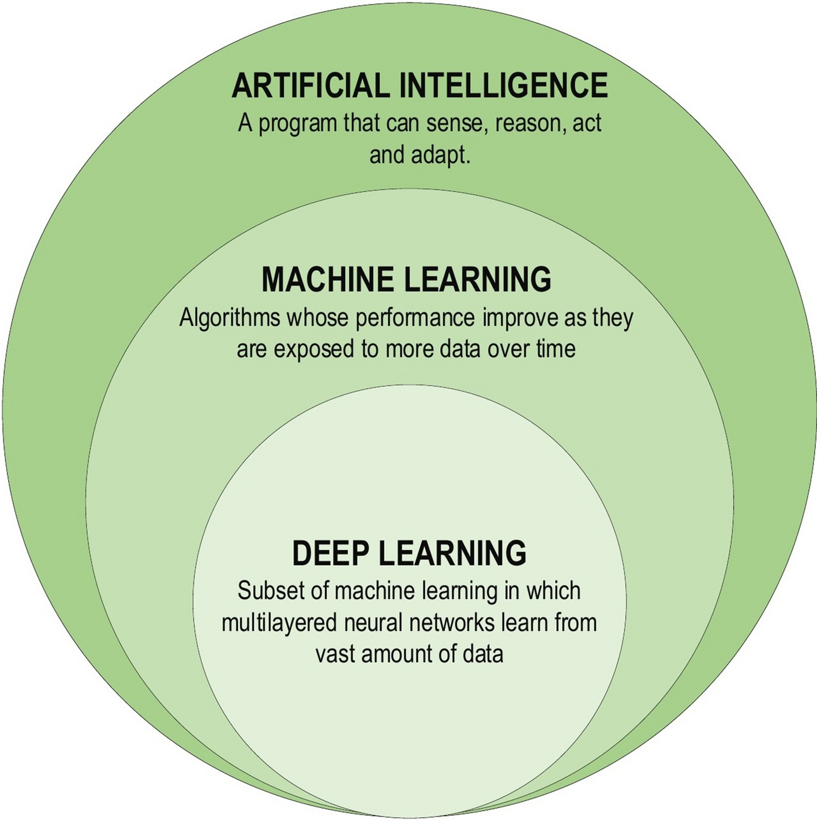

Slide 3
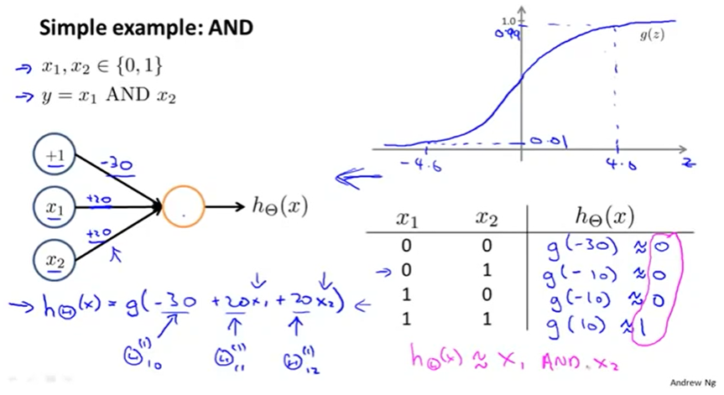

Slide 4
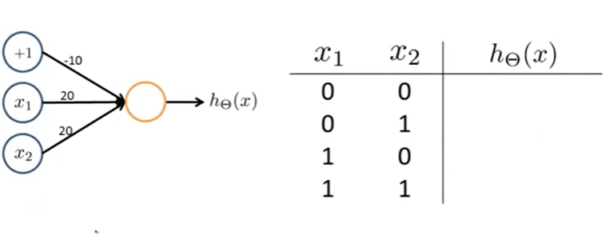
???

Slide 5
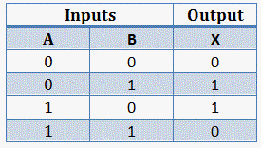
XNOR?
X
x2
X
x1

Slide 6
